Slide 1
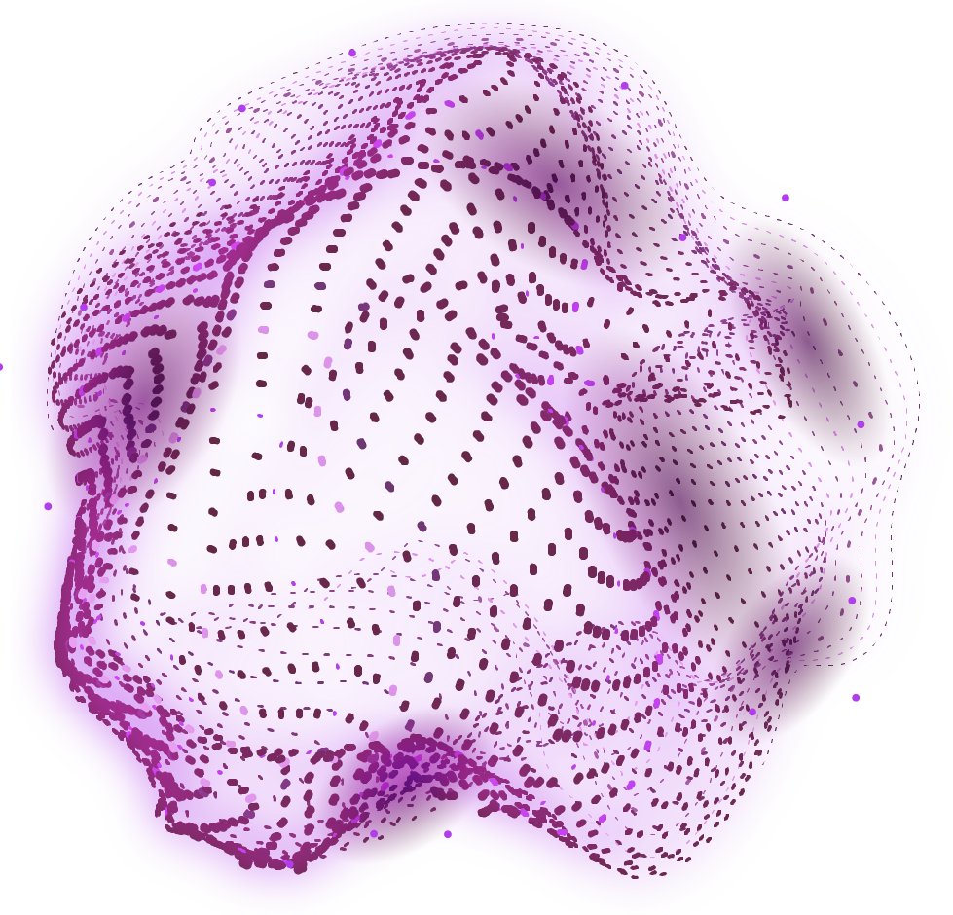


SMART CITY USING AI

Slide 2
ABOUT THE IDEA

Slide 3

A smart city, powered by AI, is a technologically advanced urban area that utilizes data and analytics to improve quality of life for its residents. AI-driven systems can optimize traffic flow, manage energy consumption, monitor environmental conditions, and enhance public services.

Slide 4
• Real-Time Traffic Monitoring and Prediction • Adaptive Traffic Signal Control • Dynamic Route Guidance • Public Transportation Optimization
Traffic Management Using AI and ML

Slide 5
• Real-Time Occupancy Detection • Dynamic Pricing
Smart Parking

Slide 6
• Optimal Waste Collection Routing • Predictive Waste Generation • Smart Waste Bins
Smart Waste Management

Slide 7
THANKS

